Slide 1


JAN CONNECT
Intelligence & Accountability Engine
VEGA HACKATHON 2026
Civic Engagement
Through Technology
A dual-portal platform empowering citizens and administrators
for transparent, efficient civic issue resolution
Problem Statement ID
Theme
Category
Team Name
WD-04
Civic Engagement
Software
CodPhoenix

Slide 2
Proposed Solution: JAN CONNECT Platform
A comprehensive civic engagement ecosystem bridging citizens and administration
Citizen Portal
Admin Portal
Personal Dashboard
Admin Dashboard
Real-time overview of submitted complaints with status tracking and analytics
Comprehensive overview: total complaints, resolution rates, category distribution
Submit Complaint
Interactive Map View
GPS-based location selection, category classification, severity levels, image uploads
Visualize complaint locations with severity-based markers and status filters
My Complaints
Track complaint lifecycle: Submitted → In Review → Assigned → Resolved
Advanced Analytics
Civic Risk Index, department performance metrics, SLA breach monitoring
Public Dashboard
Transparency through city-wide analytics: resolution rates, risk indices, performance
Complaint Management
Status updates, filtering by severity/category, detailed complaint view
Key Innovation
40%
87%
95%
Real-time synchronization • Role-based access control • Data-driven decision making
Resolution Rate
Citizen Satisfaction
Transparency Score

Slide 3
Technical Approach & Architecture
Modern, scalable, cloud-native technology stack for real-time civic engagement
Frontend Stack
Implementation Workflow
React.js - Component-based UI
1
Complaint Submission
Tailwind CSS - Responsive design
Citizen submits complaint with GPS location, category, severity, and optional images
Leaflet.js - Interactive maps
2
Real-Time Sync
Data instantly syncs across all connected devices and dashboards via Firebase
Backend Stack
3
Admin Review & Assignment
Firebase - Real-time database
Admin reviews complaint, updates status, assigns to relevant department
Firestore - NoSQL data storage
4
Department Action
Cloud Storage - Image uploads
Department addresses the issue and updates progress in real-time
Security
5
Resolution & Feedback
Complaint marked resolved, citizen receives notification, analytics updated
Role-based access control
Secure authentication
Data encryption
Real-Time
Scalable
Responsive
Secure
Synchronization
Cloud Architecture
Cross-Platform
Role-Based Access

Slide 4
Feasibility and Viability Analysis
Comprehensive assessment of technical, operational, and economic viability
Technical Feasibility
Operational Feasibility
Economic Viability
Proven Technologies
Intuitive UI/UX
Low Infrastructure Cost
React, Firebase, and Leaflet are mature, well-documented technologies with strong community support
Clean, user-friendly interface requires minimal training for both citizens and administrators
Cloud-based services eliminate need for expensive on-premise servers and maintenance
Scalable Architecture
Demo Accounts
Government Adoption
Cloud-native design allows horizontal scaling to handle increasing user loads
Pre-configured demo accounts enable immediate platform exploration without registration
Aligns with Digital India and Smart City initiatives, increasing adoption potential
Real-Time Capability
Mobile Responsive
Cost Savings
Firebase's real-time database ensures instant data synchronization across all users
Works seamlessly across devices, enabling on-the-go complaint submission and management
Reduces manual complaint handling costs and optimizes resource allocation
Risk Mitigation Strategies
1 Data Privacy
2 Scalability
3 User Adoption
Secure authentication, role-based access control, data encryption at rest and in transit
Cloud-native architecture with auto-scaling capabilities, load balancing, and CDN integration
Simple interface design, multi-language support, offline capability, extensive user training

Slide 5
Impact and Benefits
Transforming civic governance through transparency, efficiency, and citizen empowerment
Social Impact
Economic Benefits
Environmental Impact
Citizen Empowerment
Cost Reduction
Waste Management
Enables active participation in civic governance, giving citizens a voice in community improvement
Eliminates manual complaint handling, paper-based records, and reduces administrative overhead
Better tracking of sanitation issues leads to cleaner neighborhoods and improved public health
Transparency
Resource Optimization
Water Systems
Public dashboard ensures accountability in public service delivery and resource allocation
Data-driven insights enable better resource allocation and priority-based issue resolution
Improved drainage and water supply management reduces flooding and waterlogging
Bridging Gap
Improved Efficiency
Urban Sustainability
Connects citizens directly with administration, reducing communication barriers
Proactive maintenance based on complaint patterns reduces long-term infrastructure costs
Proactive infrastructure maintenance reduces urban decay and promotes sustainable development
40%
87%
95%
48h
Resolution Rate
Citizen Satisfaction
Transparency Score
Avg. Resolution
Current Performance
User Experience
Public Accountability
Response Time

Slide 6
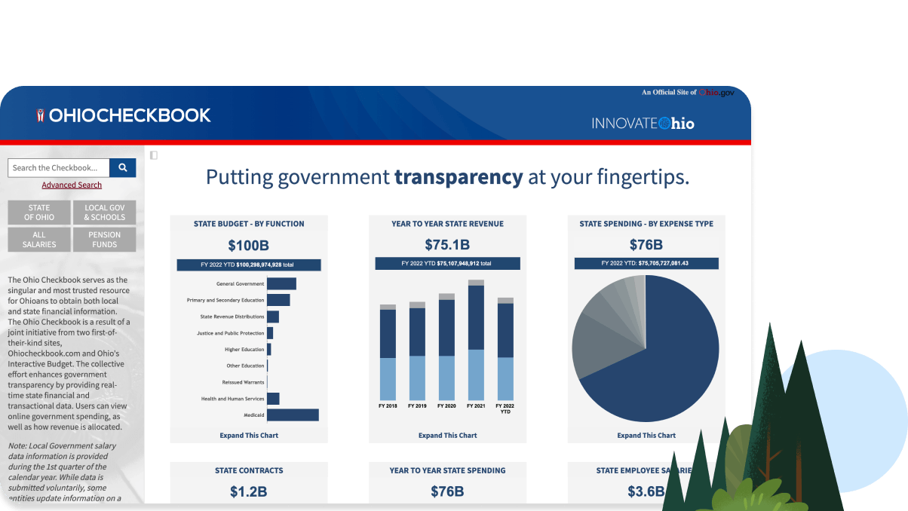
Research and References
Building on proven technologies and established civic tech frameworks
Technology References
Civic Tech & Policy
React.js Documentation
Smart City Mission India
Component-based UI development framework
Government initiative for urban transformation
Firebase & Firestore
Digital India Program
Real-time database and cloud storage solutions
National initiative for digital empowerment
Leaflet.js & OpenStreetMap
SeeClickFix Platform
Interactive map integration and geolocation services
Reference civic issue reporting platform
Tailwind CSS
FixMyStreet (UK)
Utility-first CSS framework for responsive design
Pioneering civic reporting platform case study
Research Areas
Civic Engagement Platforms
Real-Time Database Systems
Government Digitization
UX in Public Services
Transparency Metrics
JAN CONNECT
Empowering Citizens • Transforming Governance

